Slide 1
Simplifying Service Oriented Applications with
The Apache Tuscany project
Jeremy Boynes
27 July 2006

Slide 2
SOA - What is it?
Architecture for building loosely-coupled applications
Characteristics
  Applications provide and consume services
  Services have clearly defined contract separate from their implementation
  Operations exchange information between consumer and provider
  Implementations can be be built up from smaller ones
Connections are as important as applications
There are a lot of both
Consumer
Provider

Slide 3
Beyond Web Services
Web Services have been critical to SOA evolution
  Provided a clear need for some form of solution
  Stimulated evaluation and implementation of SOA
  Exposed many of the challenges of loosely-coupled solutions
  Provided clarity into the issues
  Help specification of solutions
But they have also …
  Contributed a lot of complexity
  Contributed a lot of overhead

Slide 4
Beyond Integration
Organizations faced with challenges connecting applications
  Users demanding more complex applications
  “Legacy” applications not open to integration
  Exceeded capabilities of tape, file exchange, carrier pigeon
Web Services presented as a solution
  But bitten by complexity
  Double whammy: web services + J2EE

Slide 5
THIS SHOULD NOT BE SO HARD

Slide 6
SCA Approach
There are just two things that are important:
  What resources you have
  How they are connected
Create an assembly model to represent this
  Applications become components in the assembly
  Components provide and consume services
  Components connect to each other with wires
  Configuration information outside the implementations
Let programmers write applications they way they want to
  Just let the assembly handle the connections

Slide 7
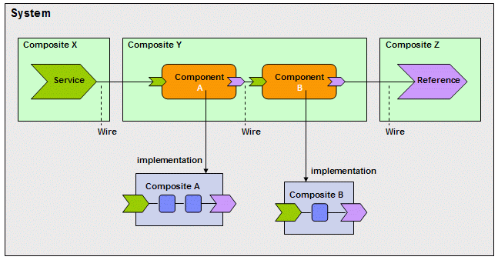
Assembly
Logical System made up of Components and Wires
Components provide and reference Services
A Component may be implemented in some language
Or it can be implemented as a Composite of other Components

Slide 8
Programming Models
Let a programmer pick the right language for the problem
  Based on technical applicability
  Or just familiarity
Define a way in which components implemented in that language can be used in an assembly
Languages include Java, C++, PHP, BPEL, JavaScript, Groovy
Model can also include programming frameworks
  Specification for Spring applications
  Support for J2EE applications such as EJBs

Slide 9
Simple Java Implementation
Provides a service an delegates to another
IoC pattern allows code to move around an assembly
  No dependency on SCA APIs e.g. for locating services
  Can be wired and re-wired by an SCA runtime
public class SourceImpl implements Source {
private Target target;
public SourceImpl(Target target) {
this.target = target;
}
public String echo(String msg) {
return target.echo(msg);
}
}
Service
Provided
Reference
to Service
Use of Service

Slide 10
XML Assembly
Defines a single composite containing two components with a wired reference between them
<composite xmlns="http://www.osoa.org/xmlns/sca/1.0"
name="LocalWireComposite">
<!-- the component that is the source end of the wire -->
<component name="SourceComponent">
<implementation.java class="localwire.cdi.SourceImpl"/>
<references>
<reference name="target" target="TargetComponent"/>
</references>
</component>
<!-- the component that is the target of the wire -->
<component name="TargetComponent">
<implementation.java class="localwire.cdi.TargetImpl"/>
</component>
</composite>

Slide 11
Going global
Exposing as a web service
<composite xmlns="http://www.osoa.org/xmlns/sca/1.0"
name="LocalWireComposite">
<service name="MyService">
<interface.wsdl wsdl=”http://www.example.com/myservice"/>
<binding.ws uri=”http://localhost/services/MyService”/>
<reference target=“SourceComponent”/>
</service>
<!-- the component that is the source end of the wire -->
<component name="SourceComponent">
<implementation.java class="localwire.cdi.SourceImpl"/>
<references>
<reference name="target" target="TargetComponent"/>
</references>
</component>
…

Slide 12
Multiple bindings
Add exposure as a Java RMI service
<composite xmlns="http://www.osoa.org/xmlns/sca/1.0"
name="LocalWireComposite">
<service name="MyService">
<interface.wsdl wsdl=”http://www.example.com/myservice"/>
<binding.ws uri=”http://localhost/services/MyService”/>
<binding.rmi uri=”//localhost/MyService”/>
<reference target=“SourceComponent”/>
</service>
<!-- the component that is the source end of the wire -->
<component name="SourceComponent">
<implementation.java class="localwire.cdi.SourceImpl"/>
<references>
<reference name="target" target="TargetComponent"/>
</references>
</component>
…

Slide 13
How Apache Tuscany can help…
Project under incubation to implement this technology
  Not an RI for the spec but something actually useful
2 SCA Runtime environments
  C++ runtime for general integration
  Java runtime for bytecode based applications
  Both (will) support implementations in multiple languages
There’s also a PHP based runtime at PECL
Related technology sub-projects
  SDO in Java and C++ to represent data
  Data Access Service for storing state

Slide 14
Tuscany Futures
Support for fine-grained services
  E.g. expose server-side Ajax handlers
Asynchronous connections
  Automatically queue and process requests
  Callbacks on completion
Conversational Services
  Application controlled conversations
  Automatic control e.g. for life of HTTP session
Support for Policy and Quality of Service
  Reliable services, security, integrity
Dynamic self-configuring assemblies
  Automatic location of services based on application criteria
  Automatic wiring of assemblies based on rules
  Rewiring and rerouting around disruptions

Slide 15
Resources
Tuscany Project
  http://incubator.apache.org/tuscany
  mailto:tuscany-dev@ws.apache.org
Specifications
  http://www.osoa.org
Contact
  Jeremy Boynes
  jboynes@apache.org

